Slide 1


Python QML Arduino GUI Training Handout
Written by :
Muhammad Husni Muttaqin, S. Pd

Slide 2

About me
Name : Muhammad Husni Muttaqin, S. Pd.
Birth date : 5 June 1998
Hometown : Bandung
Current Job : python programmer at PT Syergie Indoprima and part time teacher
Experiences :
- 2019 - 2020 : Dynamics Positioning System engineer on cable ship (PT Syergie Indoprima)
- 2021 - 2022 : Electronics and control system engineer for Vent-I (PT Syergie Automa Teknologi)
- 2022 – now : Python Programmer PT Syergie Indoprima

Slide 3
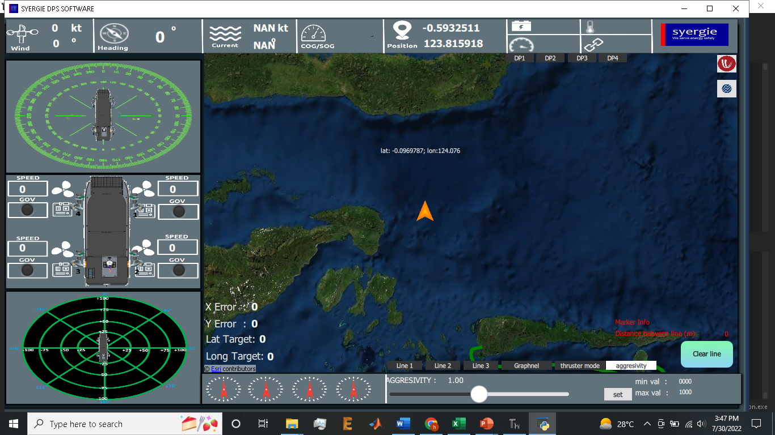
Pengalaman di pemrograman dengan python QML
1. Software Dynamic Positioning System

Slide 4
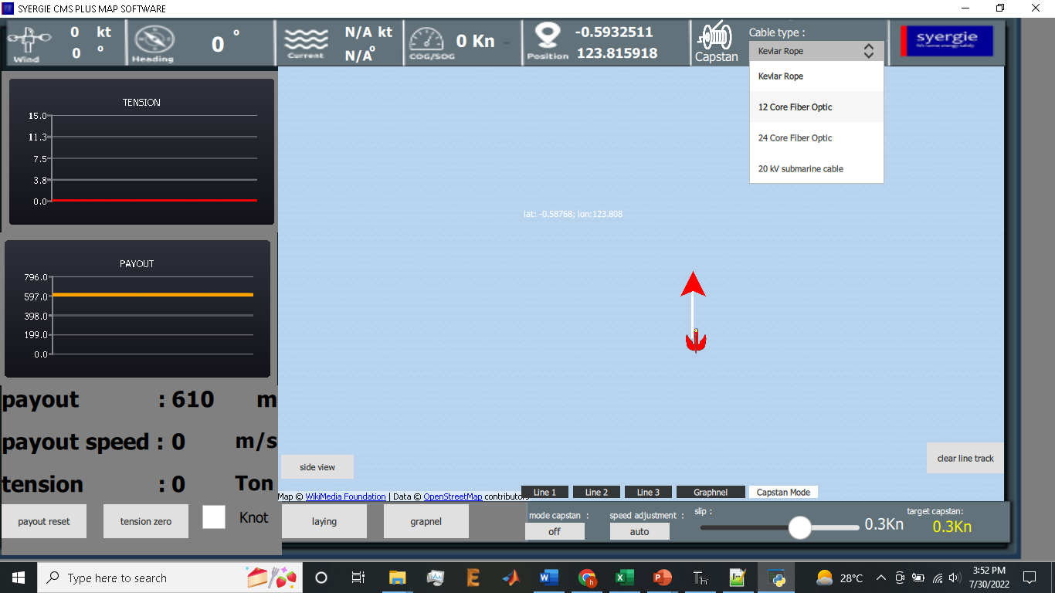
Pengalaman di pemrograman dengan python QML
2. Software Cable Management System

Slide 5
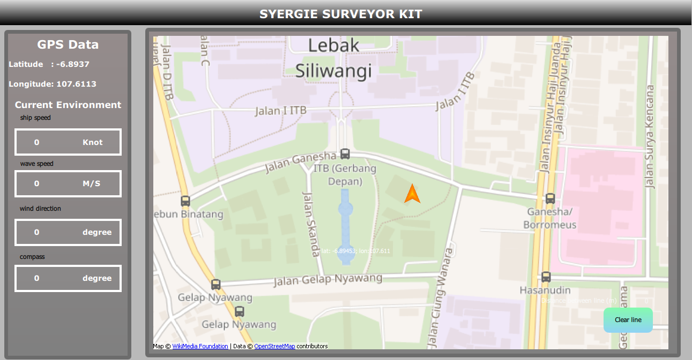
Pengalaman di pemrograman dengan python QML
3. Software Survey Arus bawah laut

Slide 6
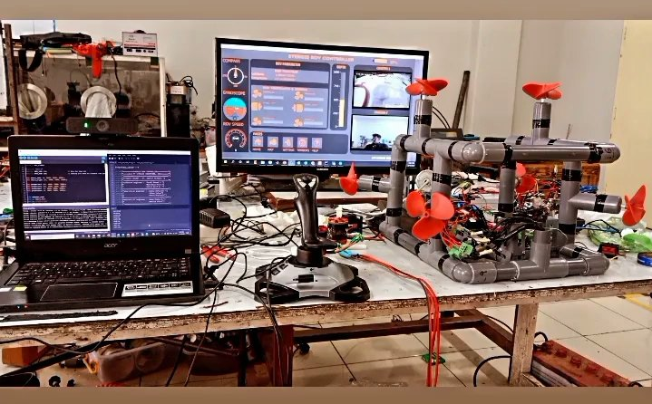
Pengalaman di pemrograman dengan python QML
4. Software kendali Underwater ROV

Slide 7
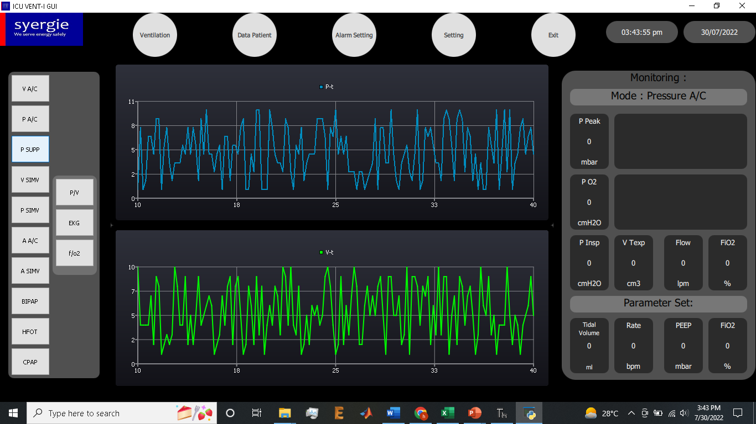
Pengalaman di pemrograman dengan python QML
5. ICU Ventilator GUI

Slide 8
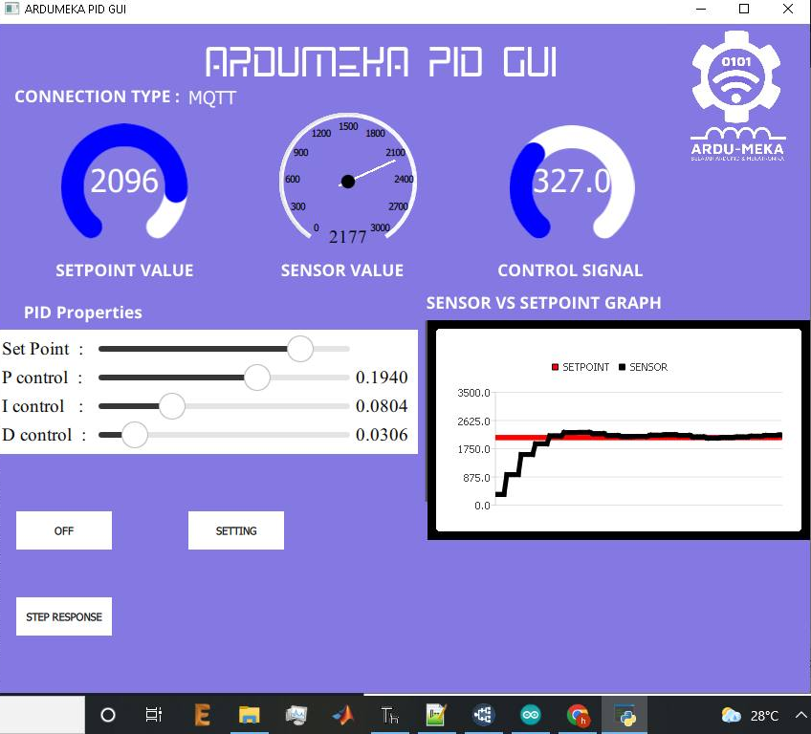
Pengalaman di pemrograman dengan python QML
6. Ardumeka PID GUI

Slide 9
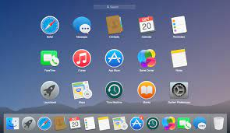
What is GUI ?

Slide 10
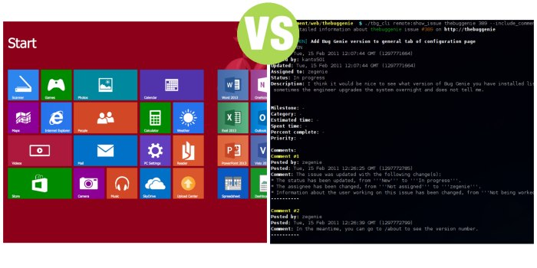
GUI vs CLI

Slide 11
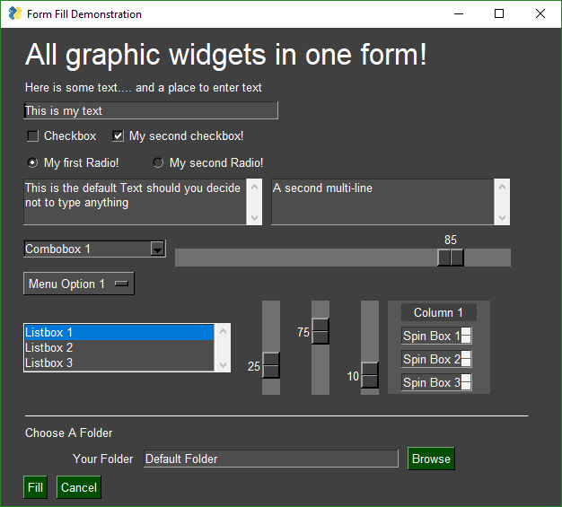
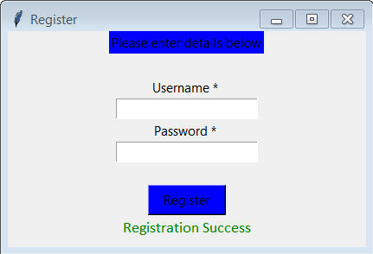
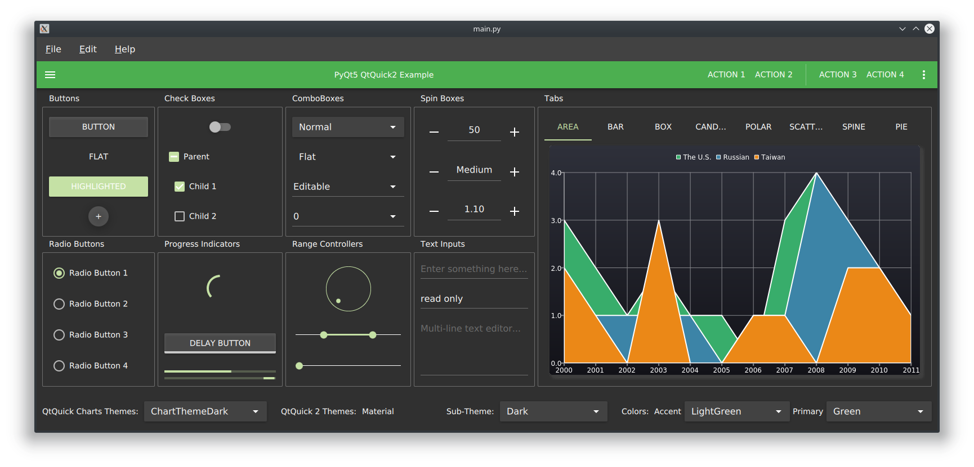
Python GUI
Tkinter
PySimpleGUI
PyQt QML

Slide 12
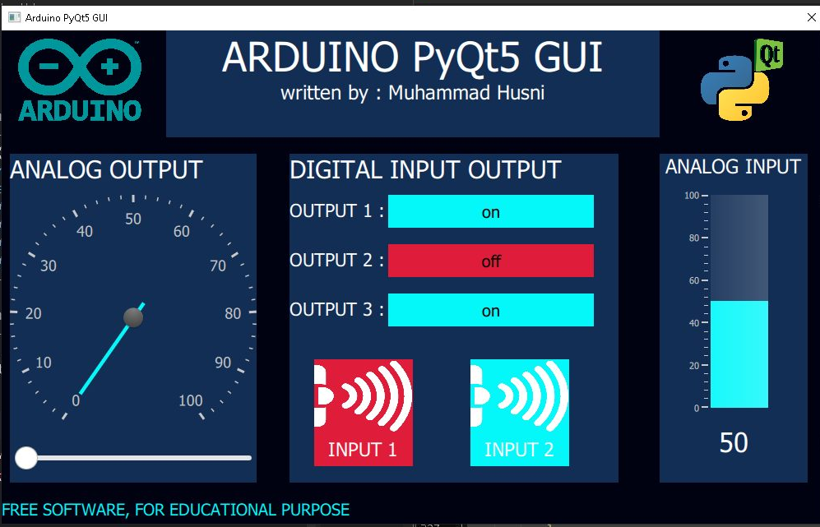
Today Workshop Project with PyQt5

Slide 13
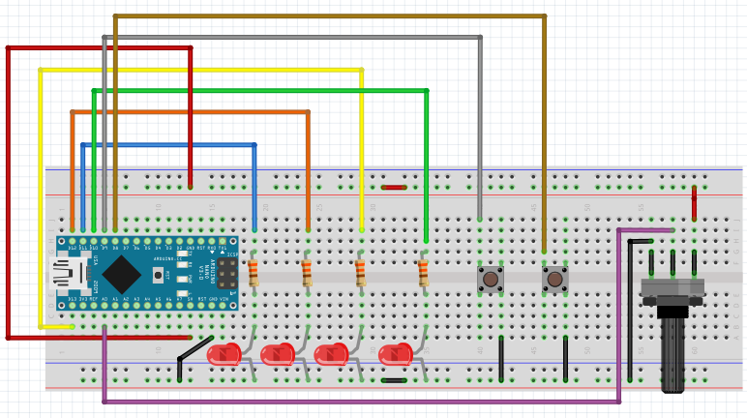
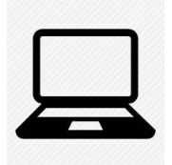

Slide 14
Preparation
Software Installation
Notepad++
Thonny IDE
- PyQt5 Library
Arduino IDE
CH340 Driver

Slide 15
Hardware Wiring

Slide 16
RUN EXAMPLE CODE FIRST TO MAKE SURE PREPARATION DONE PERFECTLY ☺

Slide 17
HOW PyQt5 WORK
add windows
add text
Add button
Add slider
Add image
Add gauge and circular gauge
Integrate python and qml
Serial data parsing

